Slide 1









Group Number
Network Security (Vulnerabilities, Threats and Countermeasures)
Supervision by: Dr. Ashish Sir
N
R/C
V/K
Naman
Rohit Chaudhary
Vishnu Kumar

Slide 2






Content
01
Introduction
04
Network Attackers Tool
02
Network Attack Types
05
Network Attack Prevention
03
Basic Network Attacks
06
References

Slide 3








Introduction
What Is Network
A network consists of two or more computers that are linked in order to share resources (such as printers and CDs), exchange files, or allow electronic communications.
A Network Attack can be defined as any method, process, or means used to maliciously attempt to compromise network security.

Slide 4
Network Attack
What Is Network Attack
Actions taken through the use of computer networks to disrupt, deny, degrade, or destroy information resident in computers and computer networks, or the computers and networks themselves.
Some common examples of reconnaissance attacks include packet sniffing, ping sweeps, port scanning, phishing, social engineering, and internet information queries.

Slide 5

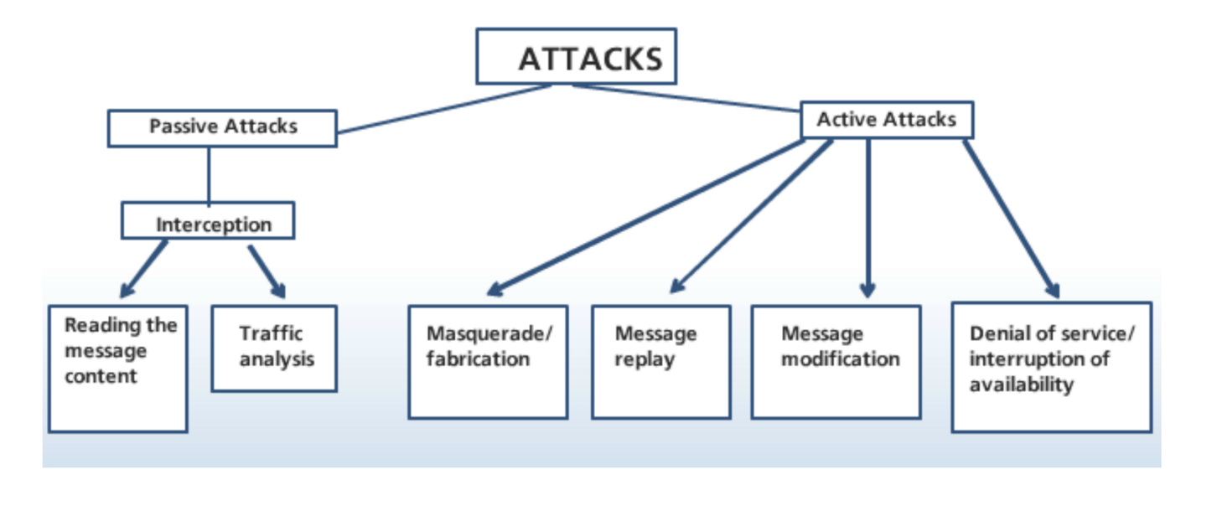
Classification Of Attacks

Slide 6


Types Of Network Attacks
ACTIVE ATTACK
PASSIVE ATTACK

Slide 7
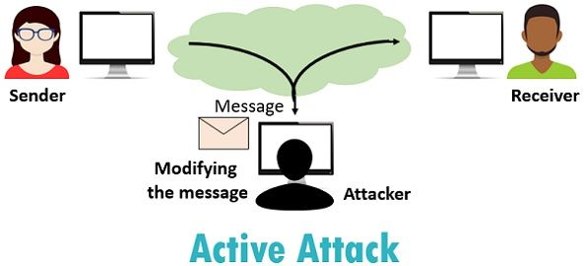
ACTIVE ATTACK
Active attack tries to change the system resources or affect their operation. Always causes damage to the system.

Slide 8
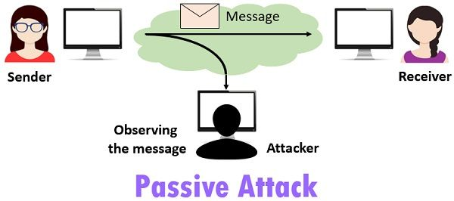
Passive attack
Passive attack tries to read or make use of information from the system but does not influence system resources.

Slide 9
Basic Network Attacks
01
Password Based Attack
04
IP Spoofing
02
Malware Attack
05
Man in the Middle Attack
03
DOS Attack
06
XSS Attack

Slide 10


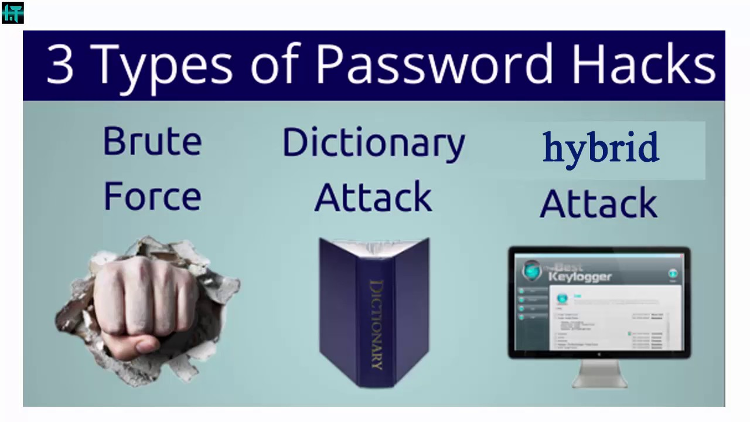

Password Based Attack
A password attack refers to any of the various methods used to maliciously authenticate into password-protected accounts. These attacks are typically facilitated through the use of software that expedites cracking or guessing passwords.

Slide 11
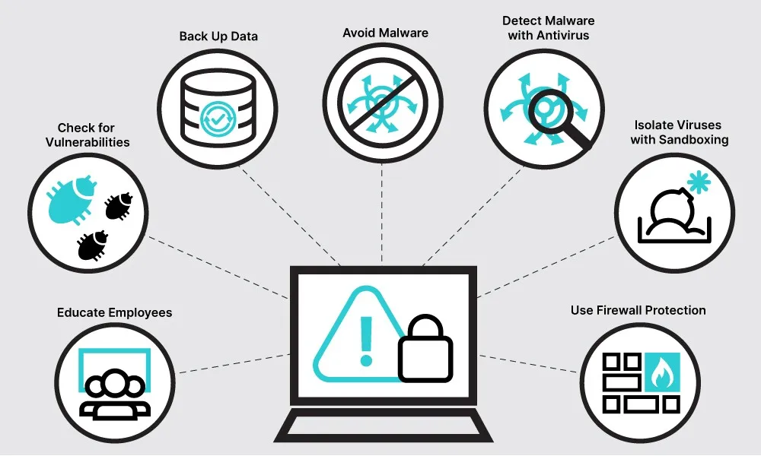
Malware Attack
A malware attack is a common cyberattack where malware (normally malicious software) executes unauthorized actions on the victim's system.

Slide 12
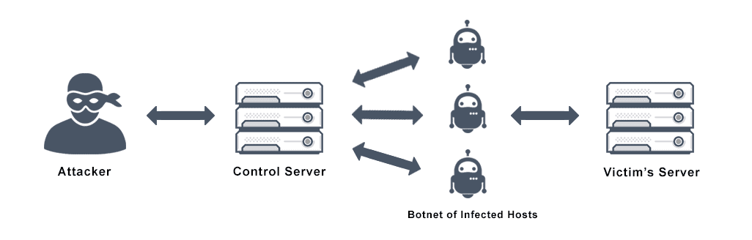
DOS Attack
A Denial-of-Service (DoS) attack is an attack meant to shut down a machine or network, making it inaccessible to its intended users. DoS attacks accomplish this by flooding the target with traffic or sending it information that triggers a crash.

Slide 13
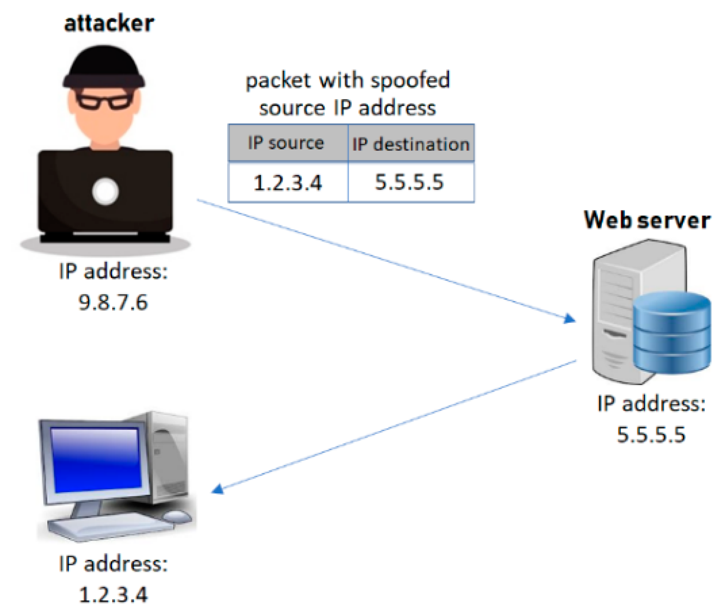
IP Spoofing
IP spoofing, or IP address spoofing, refers to the creation of Internet Protocol (IP) packets with a false source IP address to impersonate another computer system.

Slide 14
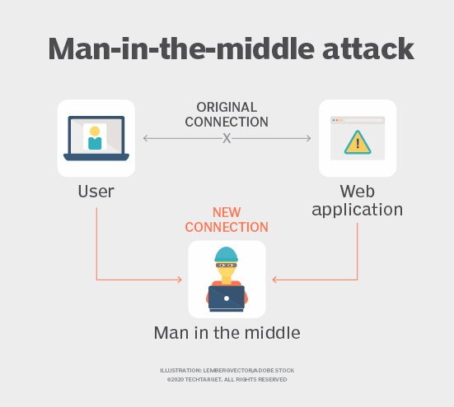
Man in the Middle Attack
A man-in-the-middle attack is a type of cyber attack in which the attacker secretly intercepts and relays messages between two parties who believe they are communicating directly with each other.

Slide 15
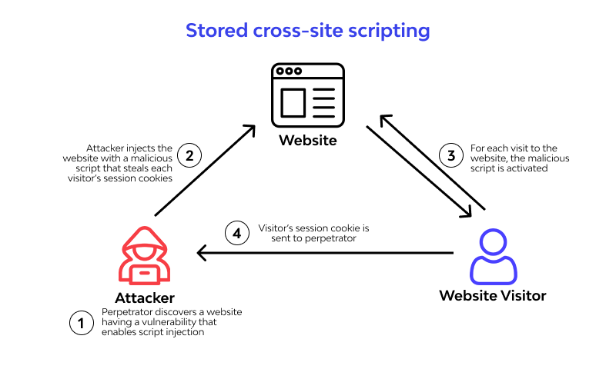
XSS Attack
XSS attacks, are a type of injection attack that injects malicious code into otherwise safe websites. An attacker will use a flaw in a target web application to send malicious code, most commonly client-side JavaScript, to an end user.

Slide 16
Network Attackers Tool
Ettercap
SQL map
Kali Linux
Social Engineering Tool Kit
Cain and Able

Slide 17

Network Attack Prevention
Install Software Updates
Use Unique Password
Use Two Factor AUTHENTICATION
USE STRONG PASSSWORD
USE A PASSWORD MANAGER
Use a firewall for your Internet connection.
Clear Browser after Leaving Computer
Browse Safely Online

Slide 18
Experiments
Firewall Implementation
Man in Middle Attack
DHCP Snooping
Network Address Translation

Slide 19
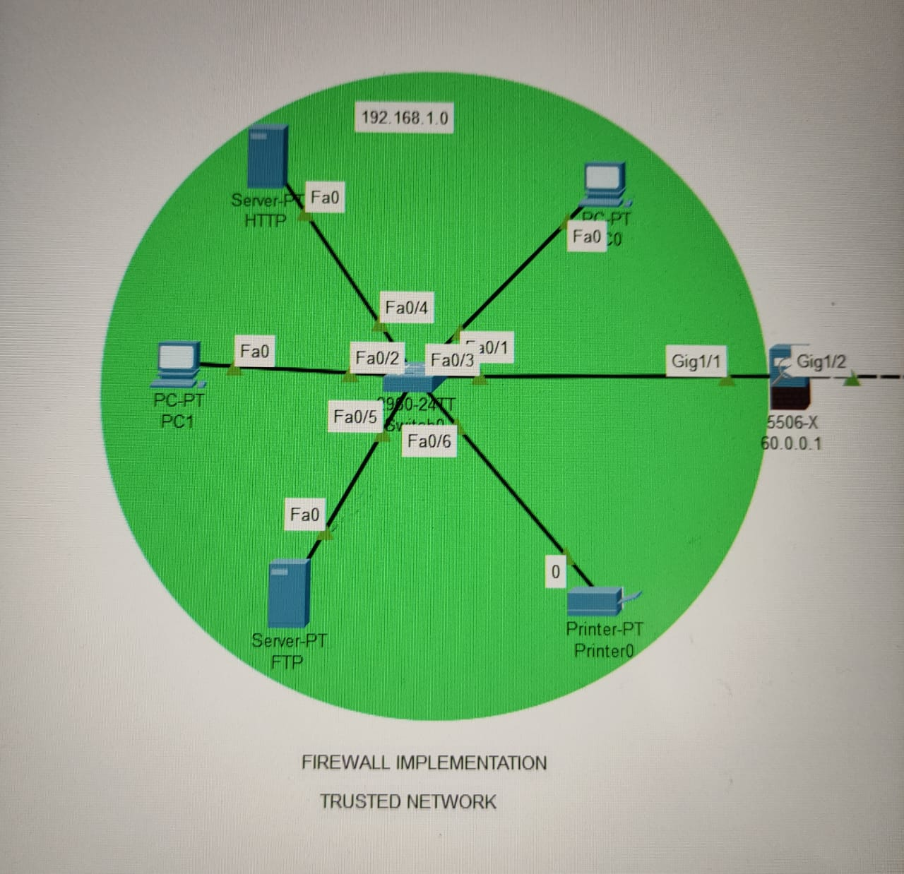
Firewall Implementation

Slide 20
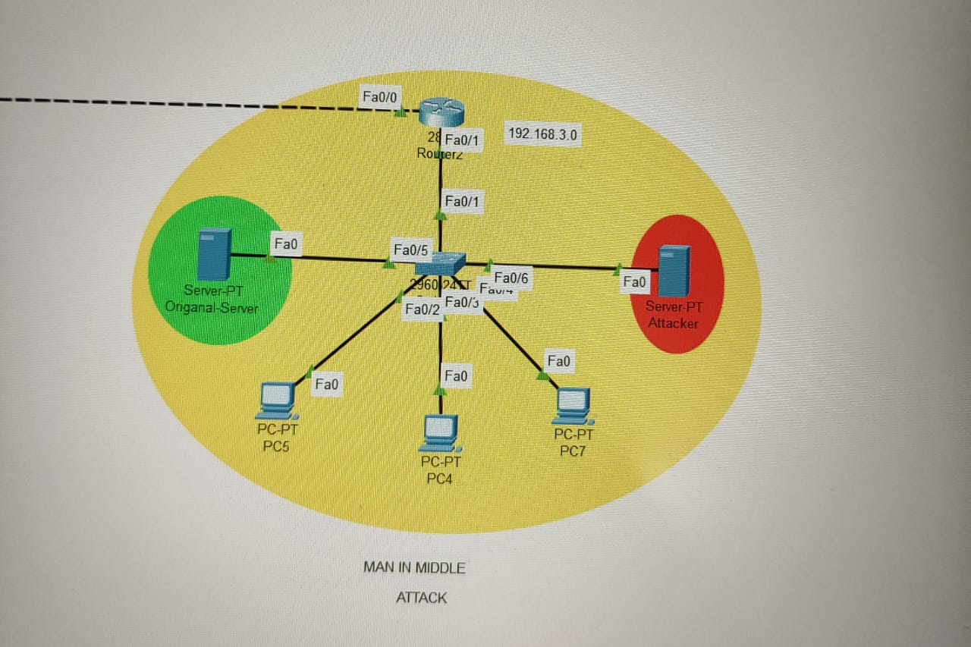
Man in Middle Attack

Slide 21
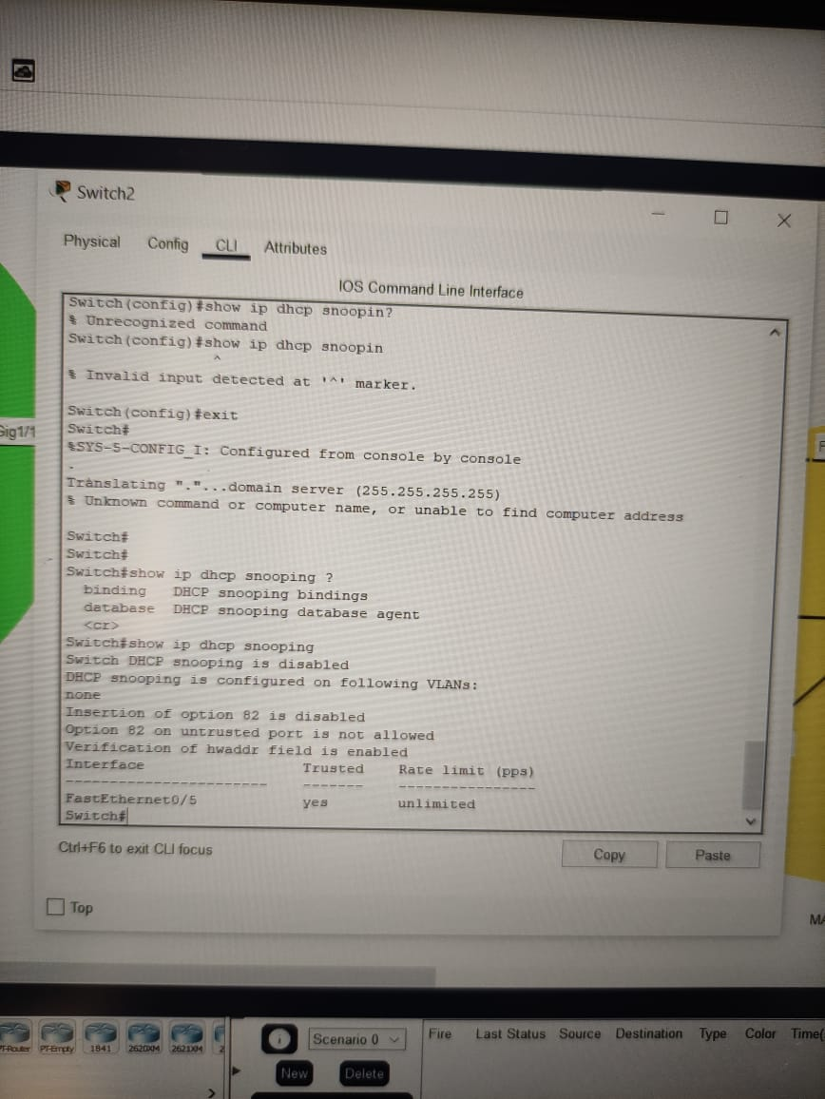
DHCP Snooping

Slide 22
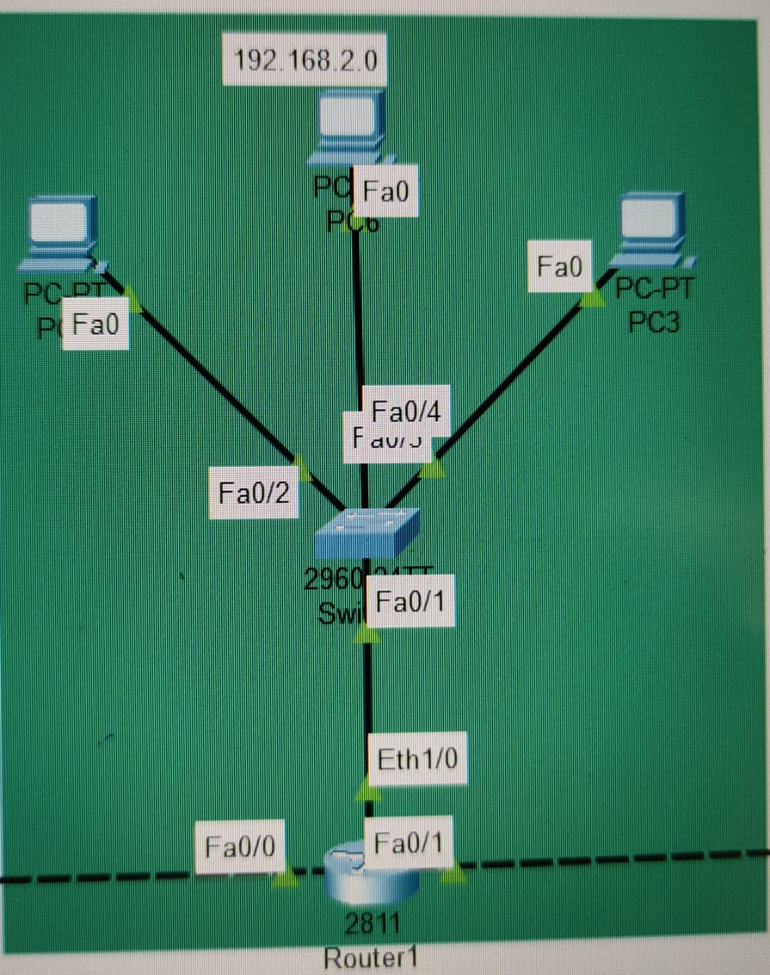
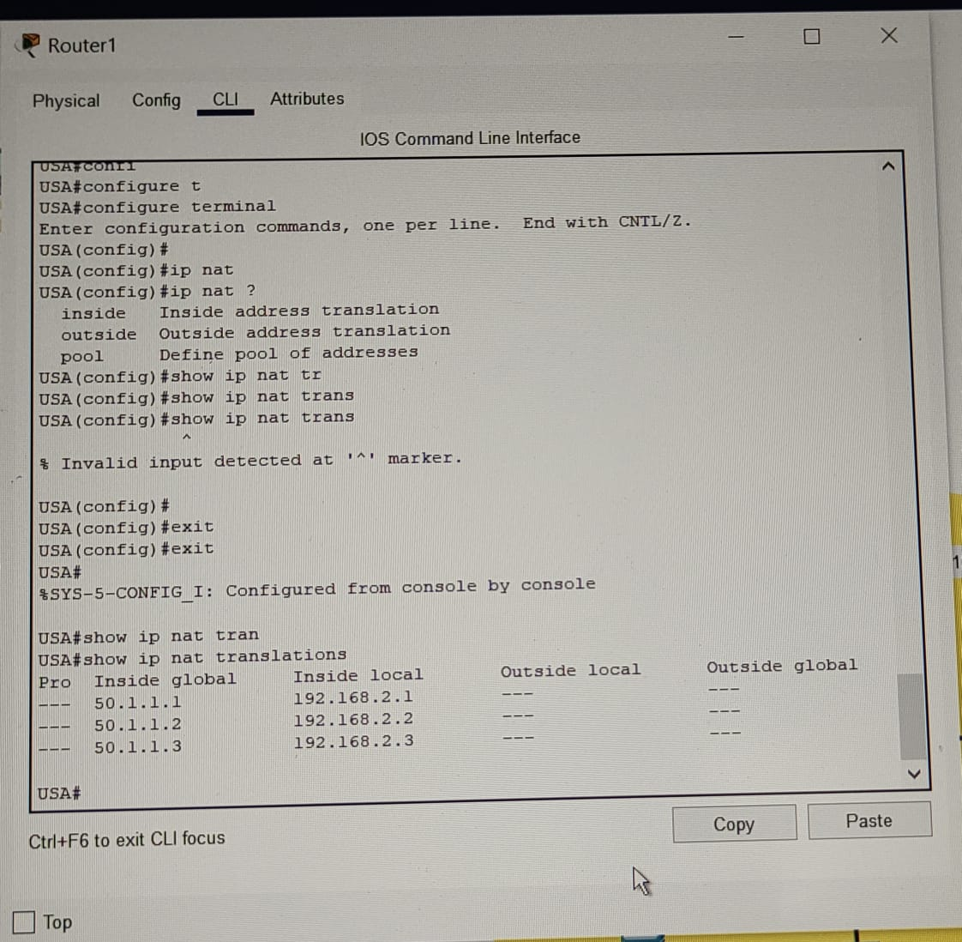
Network Address Translation

Slide 23
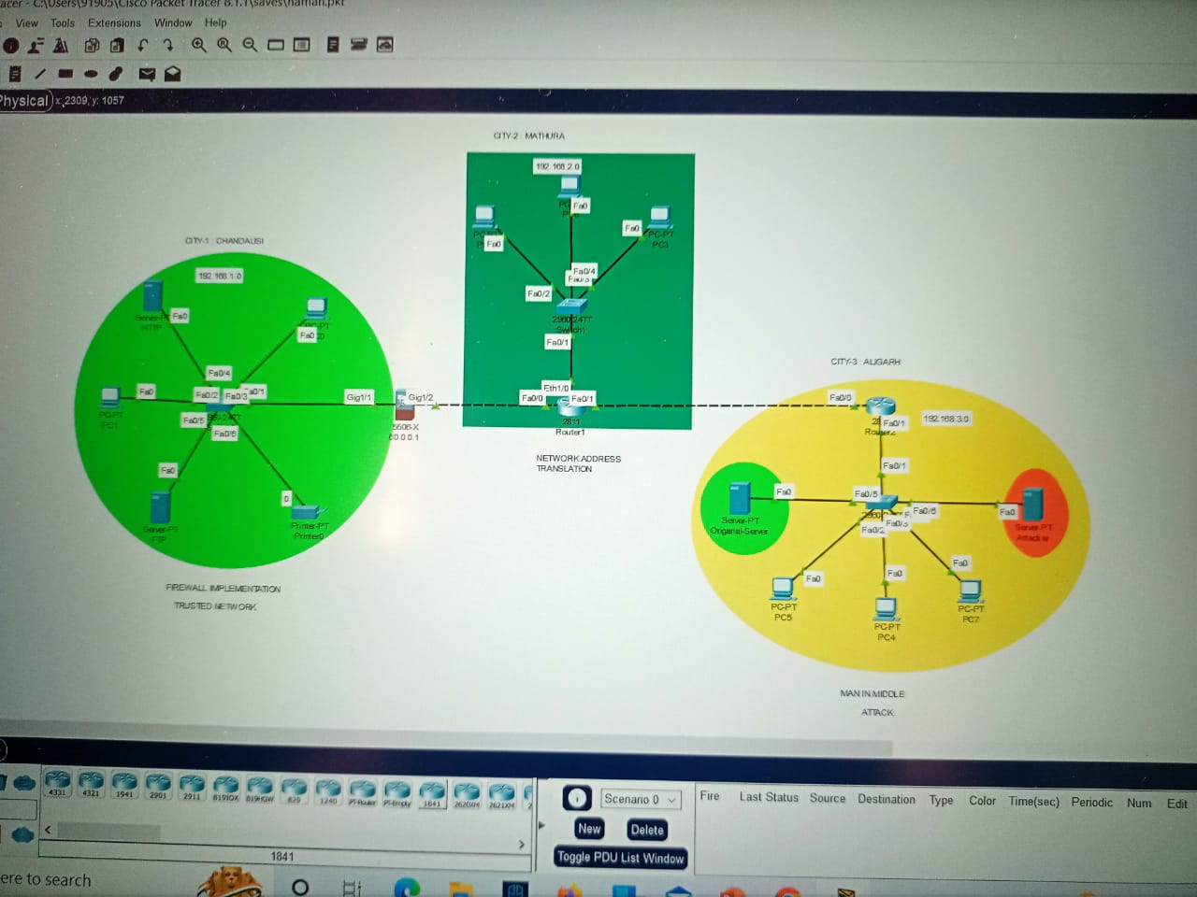
Conclusion and Future Work
01
03
04

Slide 24
References
https://networklessons.com/cisco/ccna-200-301/network-security-threats-vulnerabilities-and-countermeasures#Address_spoofing
https://www.youtube.com/watch?v=5kCGv9mfuDQ&t=932s&ab_channel=CiscoNetworkLearning
https://www.netacad.com/courses/packet-tracer

Slide 25
Conclusion and Future Work
Summary
01
Firewalls defend your computer or network from outside cyber attackers by filtering out dangerous or superfluous network traffic.
03
DHCP snooping blocks unauthorized IP traffic from untrusted ports and prevents it from entering the trusted network.
02
Having a strong encryption mechanism on wireless access points prevents unwanted users from joining your network just by being nearby.
04
NAT conserves global addresses, which allow us to add millions of hosts to the Internet without "real" IP addresses. This provides flexibility in our corporate networks. NAT can also allow you to use the same subnet more than once in the same network without overlapping networks.

Slide 26




Any Queries

Slide 27
Thank You

